Slide 1
Lecture 28

Slide 2
Question
Water is flowing down a river. Is the water velocity largest at the top or the bottom or the middle?
Top
Bottom
Middle

Slide 3
v_{t}
v_{b}

Slide 4
Question
We found that the water at the top of the river was fastest (at least for laminar flow) Does this work for air as well?
Yes
No
Kind of

Slide 5
v_{t}
v_{b}

Slide 6
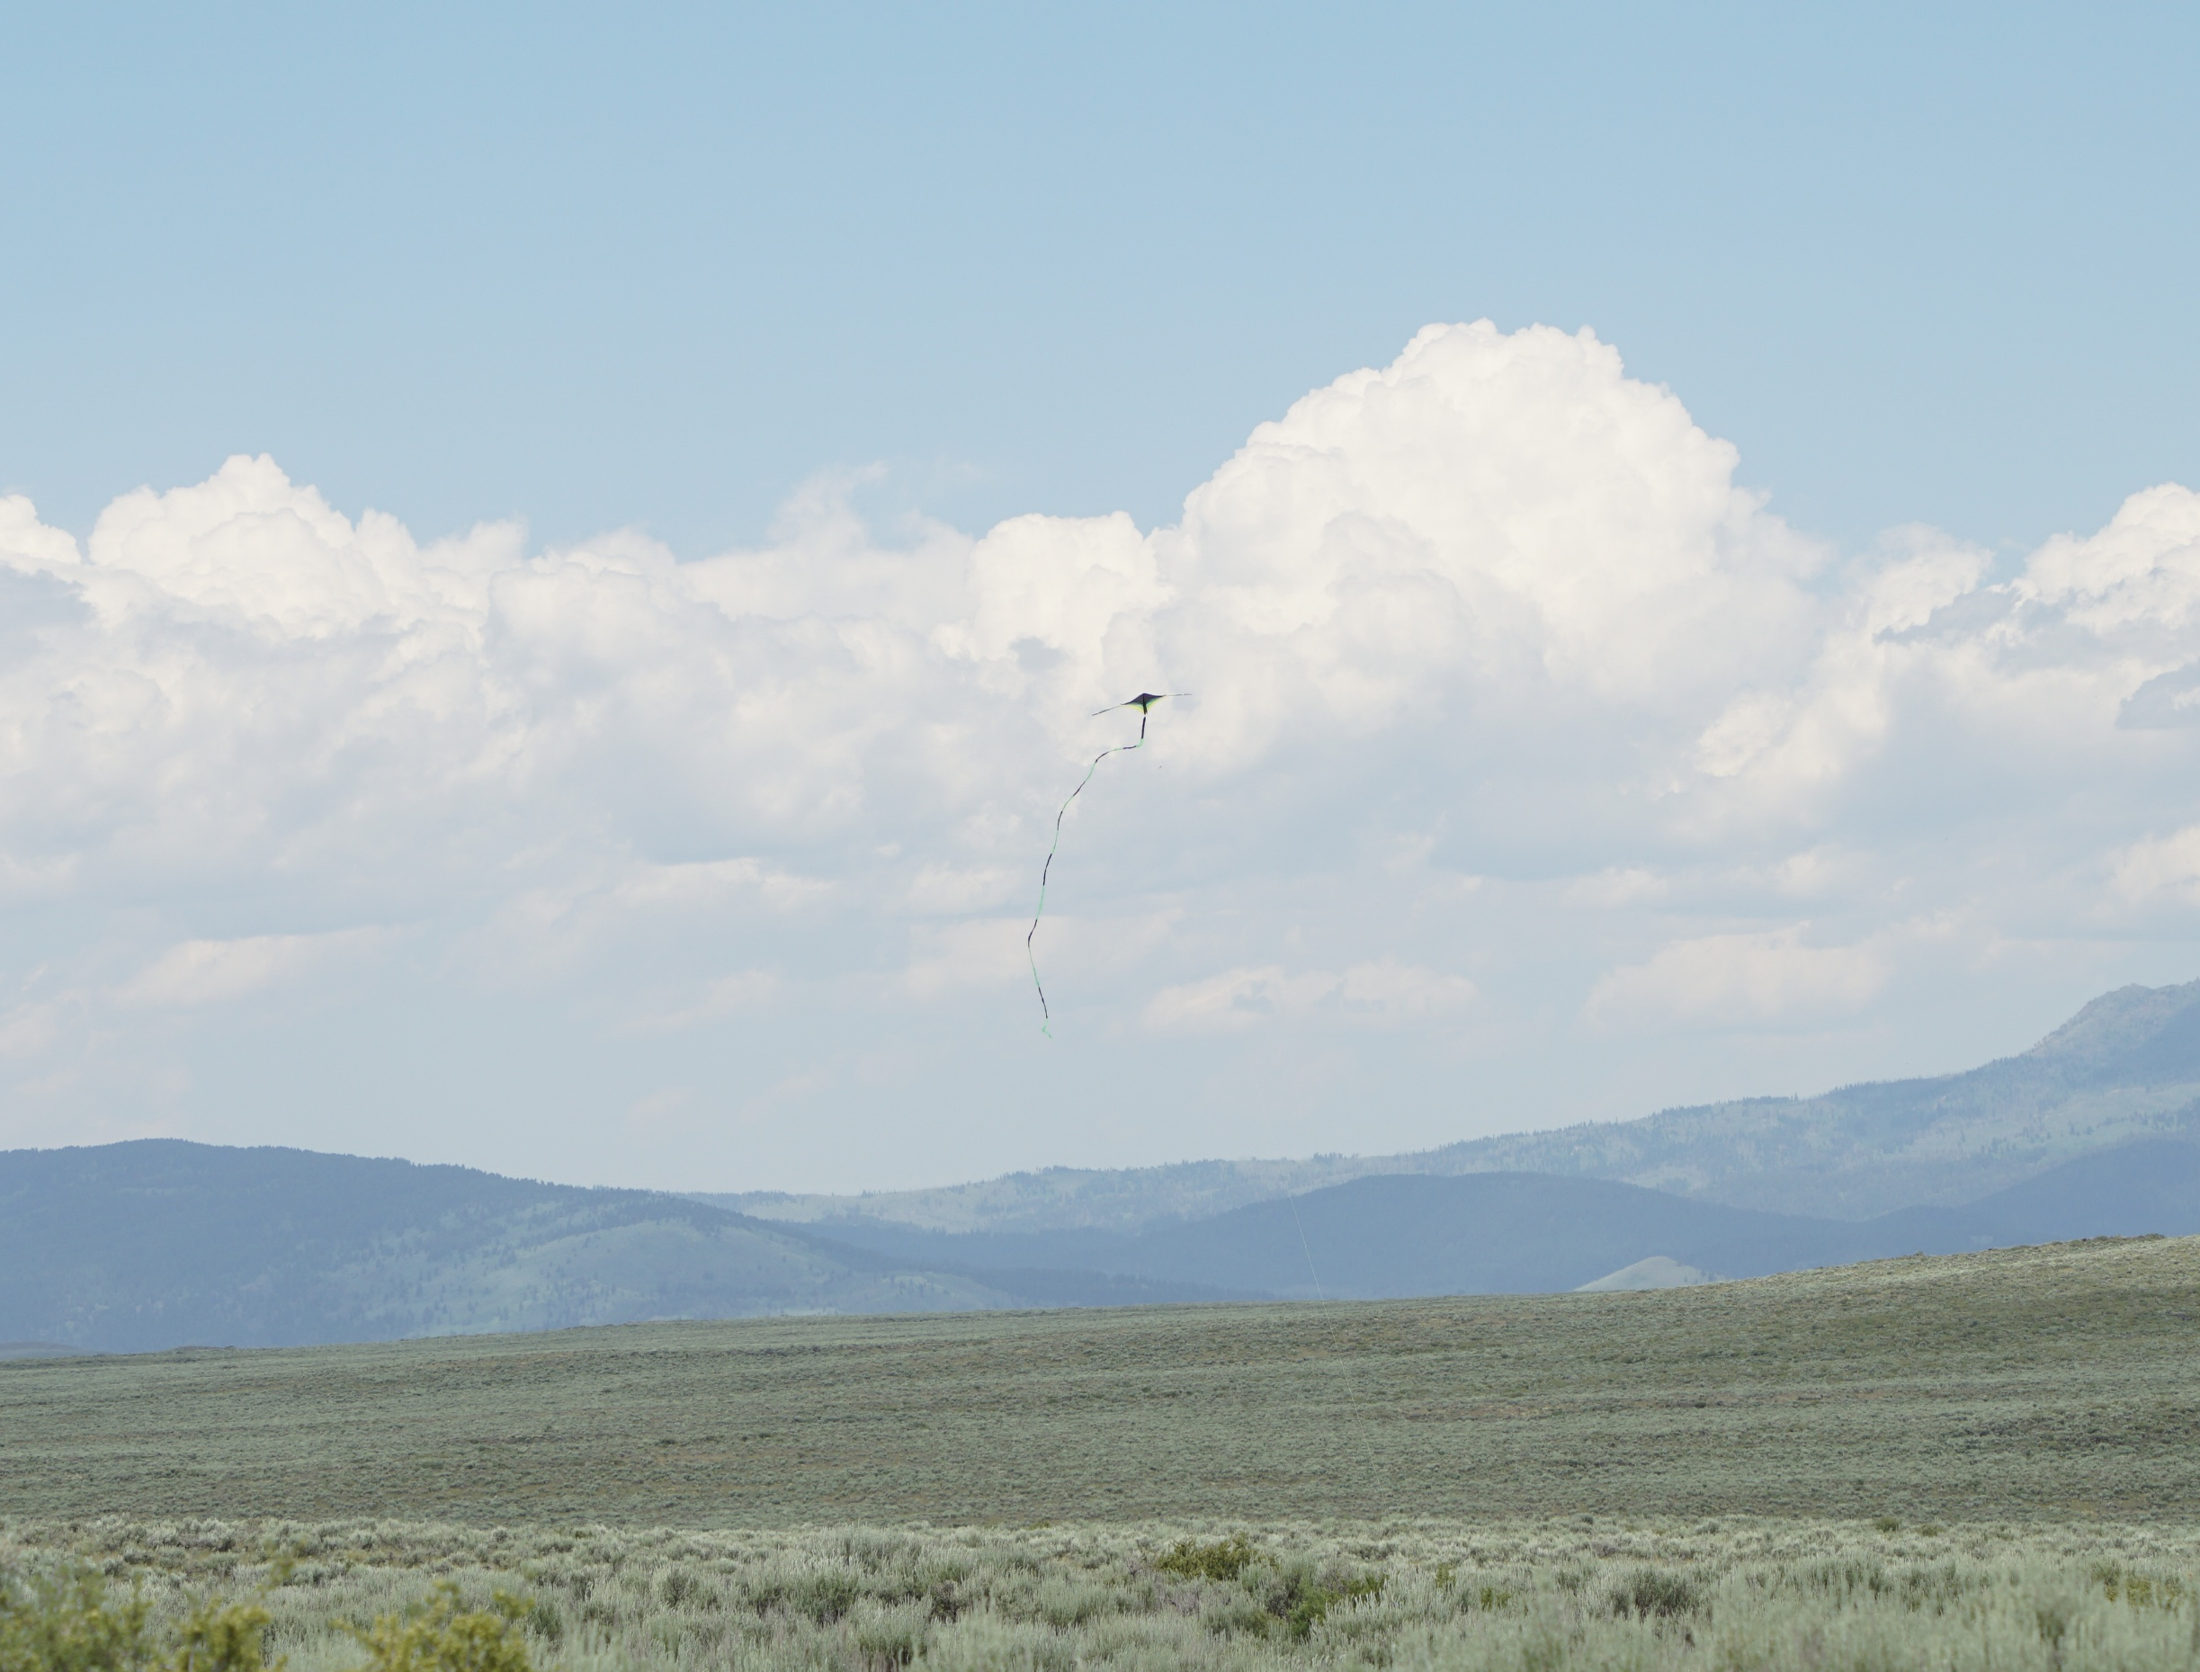

Slide 7
A
F
v
v=0
Δy

Slide 8

A Kelvin-Helmholtz instability on Saturn, caused by the interaction between two bands of the planet's atmosphere. Image from the Cassini probe. Caption from NASA's press release: This turbulent boundary between two latitudinal bands in Saturn's atmosphere curls repeatedly along its edge in this Cassini image. This pattern is an example of a Kelvin-Helmholtz instability, which occurs when two fluids of different density flow past each other at different speeds. This type of phenomenon should be fairly common on the gas giant planets given their alternating jets and the different temperatures in their belts and zones. The image was taken with the Cassini spacecraft narrow angle camera on October 9, 2004, at a distance of 5.9 million kilometers (3.7 million miles) from Saturn through a filter sensitive to wavelengths of infrared light centered at 889 nanometers. The image scale is 69 kilometers (43 miles) per pixel.

Slide 9
Pressure
In
Pressure
Out
A
A

Slide 10
v_{t}
v_{b}

Slide 12

Question
You have a liquid flowing through a pipe. You for some reason calculate
Where ρ is the liquid density, v is the speed, D is the pipe diameter, and η is the viscosity. You find that the result is less than 2300. You can conclude:
Poiseuille's Law will work
Poiseuille's Law will not work
Nothing, this means nothing to me
$$\frac{ρvD}{η}$$

Slide 13
Thermodynamics

Slide 14
Question 123.7.4
If two samples of matter are measured to be at the same temperature, what can we say about them.
They must be the same material
They must be the same state of matter
They must be the same phase
They must be in thermal equilibrium

Slide 15
Thermal Contact Defined
A
B

Slide 16
Thermal Contact Defined
A
B

Slide 17
Question 123.8.1
About how big is an atom?

Slide 18
Question 123.8.2
About how many atoms (rough order of magnitude) are in a typical sample of material?

Slide 19
Question 123.8.2.5
Suppose we have 25 students in a room of volume 100m³. What would we call the quantity 25/100m³?
Crowding factor
Number density
Dating opportunity factor
Population

Slide 20
Question 123.8.3
What is a number density?
How compact numbers in a particular domain. For example, real numbers are infinitely dense
The number of something in a unit of volume
The quantity of undatable people in your FHE group
A measure of total mass of an object

Slide 21
Question 123.8.4
If I have 1000 hydrogen atoms in a 1 liter volume, what is my number density?

Slide 22

Question 123.8.5
What is the atomic weight of ?
6u
12u
14u
13.567u
$${}_{6}^{12}C$$

Slide 23
Question 123.8.6
If I have a dozen eggs, how many eggs do I have?
6
12
13
24

Slide 24
Question 123.8.7
If I have a mole of eggs, how many eggs do I have?
6.02 x 10²³
12
1000
1.0 x 10⁸

Slide 25
Question 123.8.8
If I have 24 eggs, how many dozens of eggs do I have?
1
2
3
4

Slide 26
Question 123.8.9
If I have 1.24 x 10²⁴ eggs, how many moles of eggs do I have?
1
2
3
4

Slide 27
Question 123.8.10
Oxygen has an atomic mass of about 16u, what is the molar mass of O₂?
8g/mol
16 g/mol
32 g/mol
64 g/mol

Slide 28
End

Slide 30
Question 123.12.1.1
I have a sample of a substance with a heat capacity of 100J/K. How much heat can this sample hold if it is at 2000K?
2000000J
20J
0.5J
None at all

Slide 31



Slide 32
ΔT
Q

Slide 34
Specific Heat
Every substance requires a unique amount of energy per unit mass to change the temperature of that substance by 1° C
The specific heat, c, of a substance is a measure of this amount

Slide 35
Units of Specific Heat
SI units
J / kg °C
Historical units
cal / g °C

Slide 37
Heat and Specific Heat
Q = m c ΔT
ΔT is always the final temperature minus the initial temperature
When the temperature increases, ΔT and ΔQ are considered to be positive and energy flows into the system
When the temperature decreases, ΔT and ΔQ are considered to be negative and energy flows out of the system

Slide 38
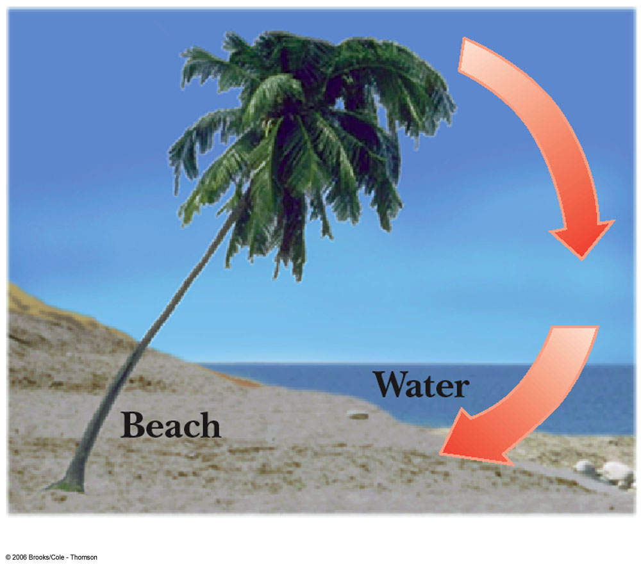
A Consequence of Different Specific Heats
Water has a high specific heat compared to land
On a hot day, the air above the land warms faster
The warmer air flows upward and cooler air moves toward the beach

Slide 39
Question 123.12.2
You add energy to an object by heat transfer. At some point, the temperature of the object stops rising. What is happening?
The system is leaking thermal energy
The system has as much heat as it can take
The object is experiencing a phase change
Can’t tell

Slide 40
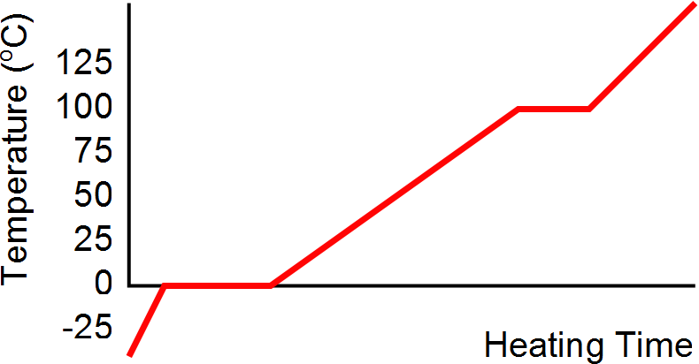
Heating Ice
Gaseous steam
Boiling water
Liquid water
Melting ice
Solid ice

Slide 41
Graph of Ice to Steam
T(ºC)
150
120
90
60
30
0
-30
Steam
Water and Steam
Water
Ice and water
0 500 1000 1500 2000 2500 3000
Ice
Energy added (J)

Slide 42
20.3 Latent Heat

Slide 43
Phase Changes
A phase change occurs when the physical characteristics of the substance change from one form to another
Common phases changes are
Solid to liquid – melting
Liquid to gas – boiling
Phases changes involve a change in the internal energy, but no change in temperature

Slide 44
Latent Heat
During a phase change, the amount of heat is given as
Q = ±m L
L is the latent heat of the substance
Latent means hidden
L depends on the substance and the nature of the phase change
Choose a positive sign if you are adding energy to the system and a negative sign if energy is being removed from the system

Slide 45
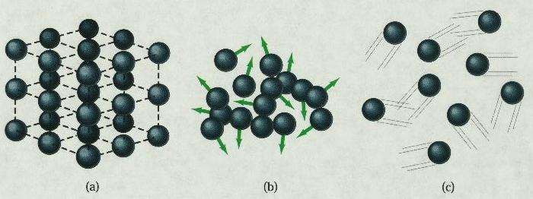
Phase Changes Latent Heat
Solid
Liquid
Gas
During a phase change, the internal energy changes but the temperature does not change.
Work is done against the attractive molecular forces to separate them.

Slide 46
Latent Heat, cont.
SI units of latent heat are J / kg
Latent heat of fusion, L_{f}, is used for melting or freezing
Latent heat of vaporization, L_{v}, is used for boiling or condensing
Table 11.2 gives the latent heats for various substances

Slide 47
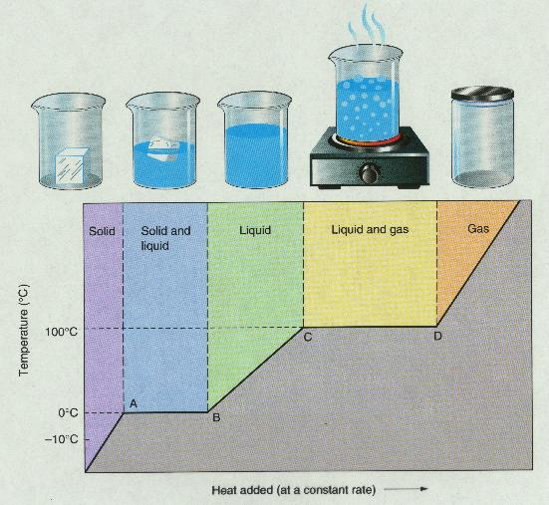
T vs. Q Graphs

Slide 49
Graph of Ice to Steam
T(ºC)
150
120
90
60
30
0
-30
Steam
Water and Steam
Water
Ice and water
0 500 1000 1500 2000 2500 3000
Ice
Energy added (J)

Slide 50
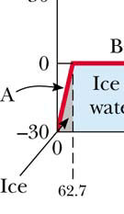
Warming Ice
Start with one gram of ice at –30.0º C
During A, the temperature of the ice changes from –30.0º C to 0º C
Use Q = m c ΔT
Will add 62.7 J of energy

Slide 51
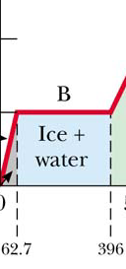
Melting Ice
Once at 0º C, the phase change (melting) starts
The temperature stays the same although energy is still being added
Use Q = m L_{f}
Needs 333 J of energy

Slide 52
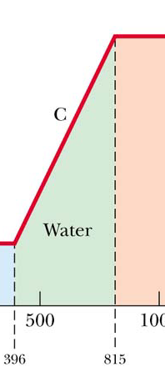
Warming Water
Between 0º C and 100º C, the material is liquid and no phase changes take place
Energy added increases the temperature
Use Q = m c ΔT
419 J of energy are added

Slide 53
Question 123.12.3
Will spaghetti cook faster if the water is boiling faster?
Yes
No
What is Spaghetti? I only eat Raman

Slide 54
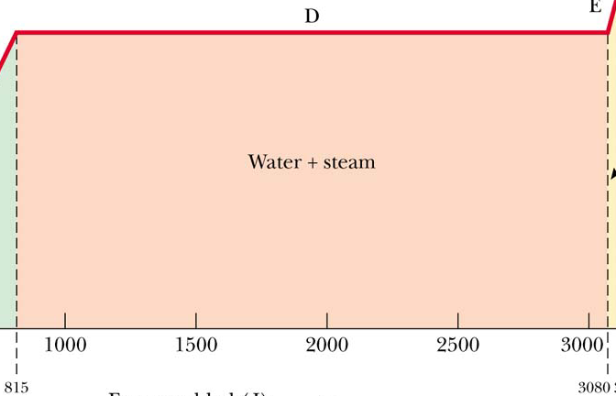
Boiling Water
At 100º C, a phase change occurs (boiling)
Temperature does not change
Use Q = m Lv
2 260 J of energy are needed

Slide 55
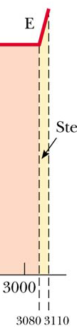
Heating Steam
After all the water is converted to steam, the steam will heat up
No phase change occurs
The added energy goes to increasing the temperature
Use Q = m c ΔT
To raise the temperature of the steam to 120°, 40.2 J of energy are needed

Slide 56
Question 123.12.4
You put 1 kg of ice at 0ºC together with 1 kg of water at 50ºC. What is the final temperature?
L_{F} = 3.33 x 10⁵ J/kg
c_{water} = 4190 J/(kg K)
a) 0ºC
b) between 0ºC and 50ºC
c) 50ºC
d) greater than 50ºC

Slide 57
Question 123.12.5
1 kg of water at 100 ºC is poured into a bucket that contains 4 kg of water at 0 ºC. Find the equilibrium temperature (neglect the influence of the bucket).
a) 0 ºC
b) 20 ºC
c) 50 ºC
d) 80 ºC
e) 100 ºC

Slide 58
Problem Solving Strategies
Make a table
A column for each quantity
A row for each phase and/or phase change
Use a final column for the combination of quantities
Use consistent units

Slide 59
Problem Solving Strategies, cont
Apply Conservation of Energy
Transfers in energy are given as Q=mcΔT for processes with no phase changes
Use Q = m L_{f} or Q = m L_{v} if there is a phase change
In Q_{cold} = - Q_{hot} be careful of sign
ΔT is T_{f} – T_{i}
Solve for the unknown

Slide 60
Calorimeter
One technique for determining the specific heat of a substance
A calorimeter is a vessel that is a good insulator which allows a thermal equilibrium to be achieved between substances without any energy loss to the environment

Slide 61
Calorimetry
Analysis performed using a calorimeter
Conservation of energy applies to the isolated system
The energy that leaves the warmer substance equals the energy that enters the water
Q_{cold} = -Q_{hot}
Negative sign keeps consistency in the sign convention of ΔT

Slide 62
Calorimeter
Sample at known temperature T_{x}
Water temperature rises
Water at known temperature T_{w}
Insulated container

Slide 63
Calorimetry
Object #1
Object #2

Slide 64
Calorimetry
Object #1
Object #2

Slide 65
Mixture Example
200 cm³ of hot water at 95ºC is poured into a 150 g glass cup initially at 25ºC. What is the final temperature of the mixture when equilibrium is reached, assuming no heat flows to the surroundings.

Slide 66
Mixture Example
200 g
What is the mass of 200 cm³ of water?

Slide 67
Calorimeter
Sample at known temperature T_{x}
Water temperature falls
Water at known temperature T_{w}
Insulated container

